Slide 1
DATABASE MANAGEMENT SYSTEM
CS23332
EXERCISE 5
RESTRICTING AND SORTING DATA
JOTHIKA K
241801110

Slide 2
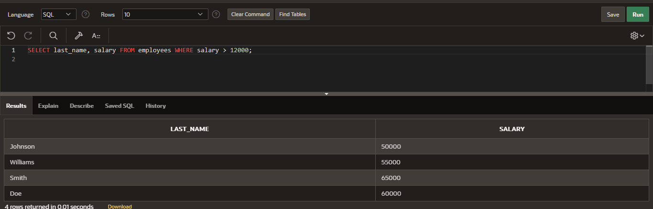
1. Create a query to display the last name and salary of employees earning more than 12000.

Slide 3
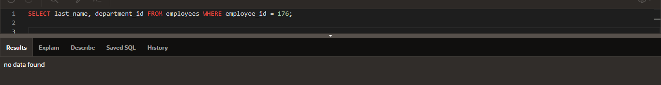
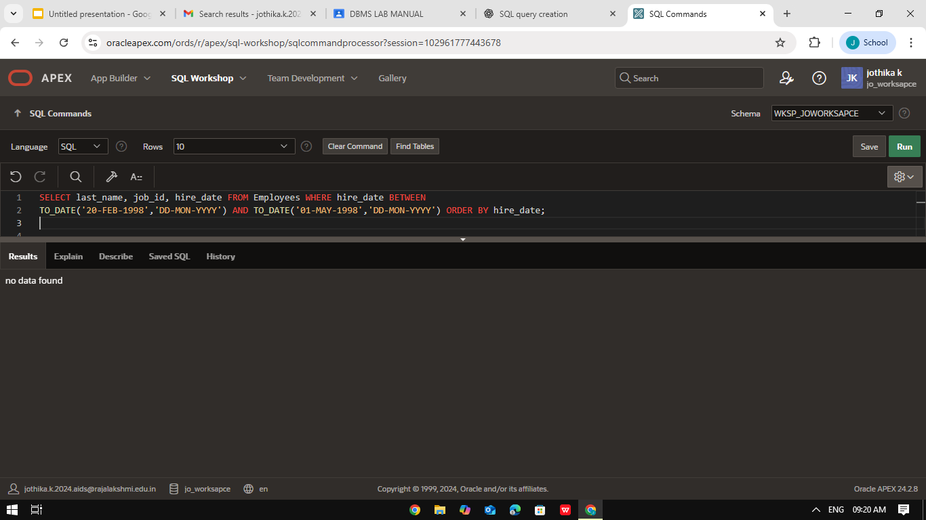
2. Create a query to display the employee last name and department number for employee number 176.
3. Display the employee last name, job ID, and start date of employees hired between February 20,1998 and May 1,1998.order the query in ascending order by start date.(hints: between)

Slide 4
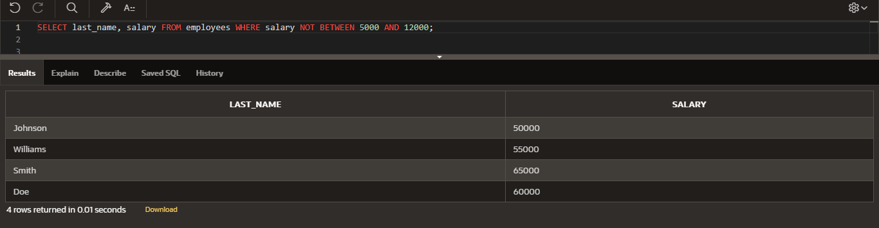
4. Create a query to display the last name and salary of employees whose salary is not in the range of 5000 and 12000. (hints: not between )

Slide 5
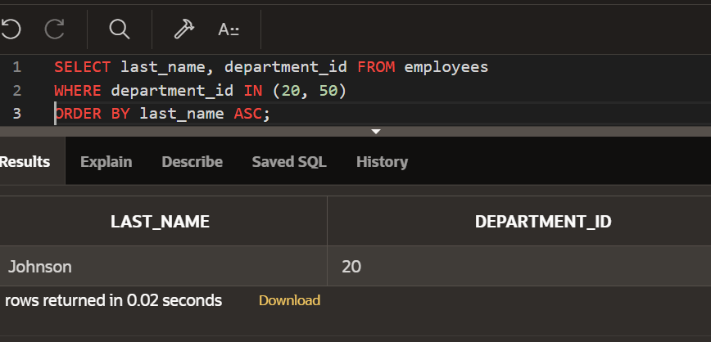
5. Display the last name and department number of all employees in departments 20 and 50 in alphabetical order by name.(hints: in, orderby)

Slide 6
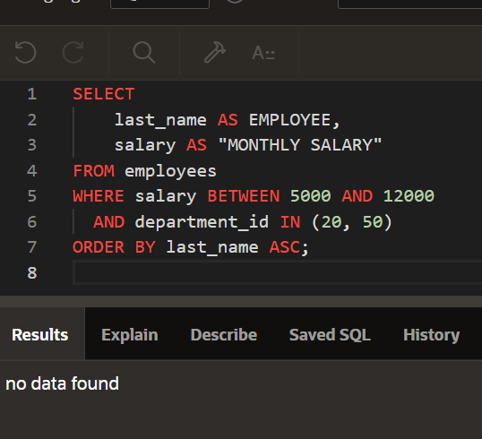
6. Display the last name and salary of all employees who earn between 5000 and 12000 and are in departments 20 and 50 in alphabetical order by name. Label the columns EMPLOYEE,MONTHLY SALARY respectively.(hints: between, in)

Slide 7
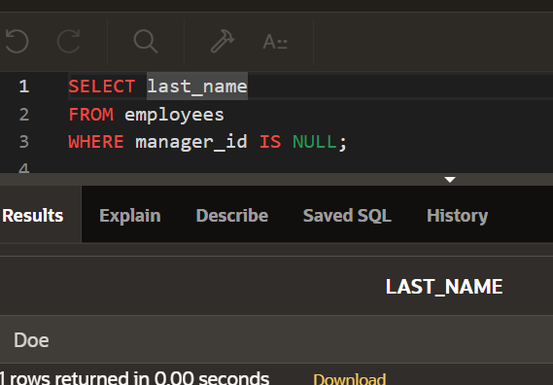
8. Display the last name and job title of all employees who do not have a manager.(hints: is

Slide 8
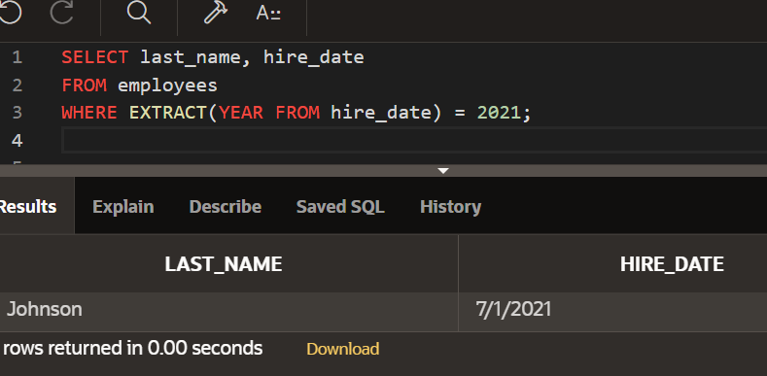
7. Display the last name and hire date of every employee who was hired in 1994.(hints: like)

